Slide 1
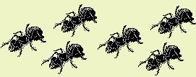
Ant Colony Optimization
-by
ABHIJITH D.A.
1PI01IS001
Notes:
Ant Colony Optimization by Abhijith D.A. – 1PI01IS001. Ants are most the powerful, but next to God, in doing anything they want.

Slide 2
ACO is based on the behaviour of Real Ants searching for Food.
Notes:
Ants communicate with each other through Pheromone.

Slide 3
Ants … ?
Real Ants
Social Insects. (Colony)
Self Organized Collective behavior.
Emergence of Complex dynamics.
Interesting Phenomena
Foraging (Search or collect Food.)
Division of Labor.
Task Allocation.
Cemetery Organization

Slide 4
Real Ants
Real Ants communicate with each other using an aromatic essence called Pheromone, which they leave on paths, they traverse. If ants sense Pheromone in their vicinity, they are likely to chose that path, thus reinforcing the path.
The Pheromone trails reflect the “Memory” of ant population.
The quantity of Pheromone deposited on the paths depends on both, the length of the paths as well as the quantity of the food source found.

Slide 5
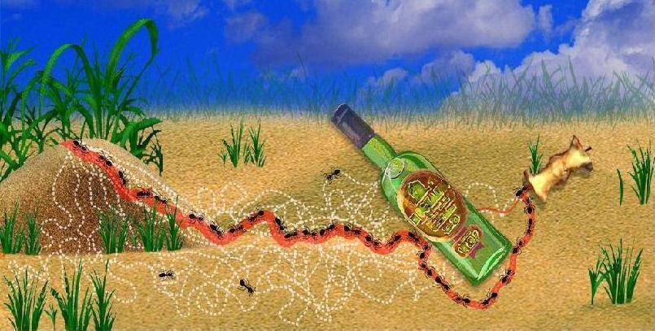
Social insects, following simple, individual rules,
accomplish complex colony Activities
through : flexibility, robustness and self-organization.

Slide 6
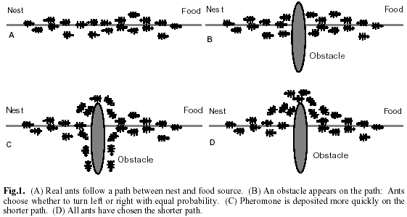
Foraging

Slide 7
What is happening?
After some time, the ants will converge to the shortest path from Nest to Food place.
How does it works…?
Ants deposits Pheromones (an aromatic substance, which evaporates after some time) on their way, while traversing.
While choosing path, they select the path, which has high density of this pheromone.

Slide 8
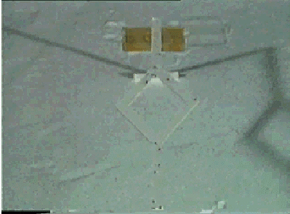
History of Ant Algorithms
Goss et al. 1989, Deneuborg et al. 1990, experiments with Argentine ants
Dorigo et al. 1991, applications to shortest path problems
Now: established method for various optimization problems

Slide 9
Definition
Ant Colony Optimization is a branch of a newly developed form of artificial intelligence called Swarm Intelligence.
  Swarm Intelligence is a field which studies “The emergent collective intelligence of groups of simple agents.”.

Slide 10
Characteristics
The essential trait of ACO is the combination of a priori information about the structure of a promising solution with a posterior information about the structure of previously obtained good solutions.

Slide 11
Design Features
Ant algorithms have been proposed as a computational approach that replaces the Traditional emphasis on control, pre-programming, and centralization with designs featuring Autonomy, Emergence, and Distributed functioning.
These designs are proving Flexible and Robust, able to adopt quickly to changing environments and to continue functioning even when individual elements fail.

Slide 12
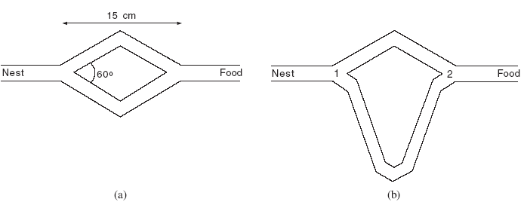
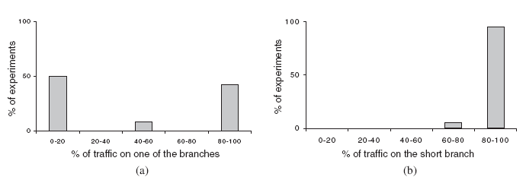
Double Bridge Experiment

Slide 13
Ant Colony Optimization as Meta-Heuristic

Slide 14
Learning and Optimization?
Machine learning: learn regularity from given training data, un-/supervised
  E.g. decision tree, neural networks, clustering, self-organizing map
Training is often reduced to optimization
  E.g. minimize the training error, optimize quantization error, optimize topology, find a minimum model, …

Slide 15
Optimization and Learning?
Discrete optimization methods like GA (Genetic Algorithms), ACO are considered as learning algorithms
  Optimize a possibly heuristic or changing function based on simple mechanisms
Learn how simple mechanisms affect the function
  Examples (individuals, ants) are explored during training

Slide 16
Real Ants as Artificial Ants.
Pheromone trails := Weight of a node or state
in a problem
Pheromone deposited is based on the
quantity of food and the distance to it. := Heuristics

Slide 17
Artificial Ants
In artificial terms the optimization method uses the trail following behaviour described above in the following way. Ants construct solutions by making a number of decisions probabilistically.
In the beginning there is no collective memory, and the ants can only follow some local information. As some ants have constructed solutions, pheromone information is built.
In Particular, the quantity of pheromone deposited by the artificial ants depends on the solution quality found by the ants.
This Pheromone information guides other ants in making their decisions. I.e. paths with high Pheromone deposited is not permanent, but rather evaporates over time. Thus over time, paths that are not used will become less and less attractive, while those used frequently will attract even more ants.

Slide 18
Functioning of ACO
(contd.)
A set of computational concurrent and asynchronous agents ( a colony of ants) moves through states of problem to solve.
They move by applying a stochastic local decision policy based on two parameters called trails and attractiveness.
By moving each ant incrementally constructs a solution to the problem. When an ant completes a solution and modifies the trail value on the components used in its solution. This pheromone information will direct the search of the future ants.

Slide 19
Functioning of ACO.
Furthermore, an ACO Algorithm includes two more mechanisms:
      Trail Evaporation and
      Daemon Actions.
Trail Evaporation decreases all the trail over time, in order to avoid unlimited accumulation of trails over some component.
Daemon Actions can be used to implement centralized actions which cannot be performed by single ants, such as the invocation of global information to be used to decide whether to bias the search from non-local perspective.

Slide 20
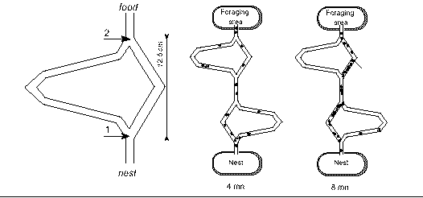
Ant Algorithms for shortest path
Ants choose paths depending on pheromone
After collecting food, paths are marked
After some time, the shortest path has the highest probability

Slide 21
General Ant Colony Heuristic (I)
For discrete optimization problem with:
Set of nodes S={1,…,N}
Edges for nodes with time-dependent costs
States = lists of nodes
Neighbourhood of states given by the edges
Constraints for feasible states, solutions
Costs for solutions given by the edge-costs

Slide 22
General Ant Colony Heuristic (II)
Ants generation
and activity
Pheromone
evaporation
Daemon
activities

Slide 23
General Ant Colony Heuristic (III)
Ants generation and activity:
while resources available: create ant
for each ant:
initialize
let ant run until a solution is found
possibly: update pheromone and routing table
compute
transition
probabilities
make decision
and move
evaluate
the current
state
update the
state
possibly
update
pheromone

Slide 24
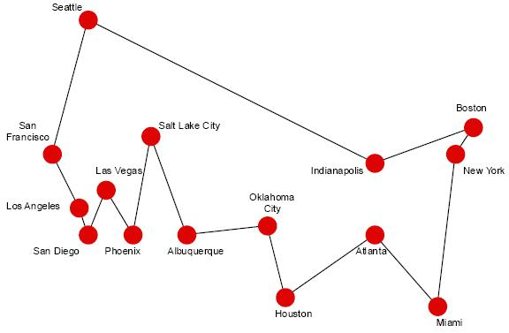
Traveling Salesman Problem (TSP)
Given N cities and a distance function d between cities, find a tour that:
Goes through every city once and only once.
Minimizes the total distance.

Slide 25
Applying ACO to TSP
The Ant System algorithm.
Loop
  Randomly position num_ants ants on num_city cities.
    For step := 1 to num_city
      For k := 1 to num_ant
        Chose the next city to move to applying a probabilistic state transition rule.
      End For
    End For
  Update pheromone trails
Until End_condition

Slide 26
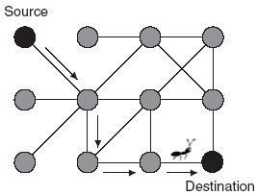
Points to be considered (contd.)
Avoid Loops.
Updating Pheromone.
Pheromone Evaporation.
How much amount of Pheromone deposit.
When to update the Pheromone.
Evaporation Rate of Pheromone.

Slide 27
Points to be considered
When to update Pheromone.
  At every move (iteration), while searching.
  After finding optimal solution.
Amount of Pheromone deposited.
  For different Time Interval -> Different or Same.
  For different distance -> Equal or Unequal.

Slide 28
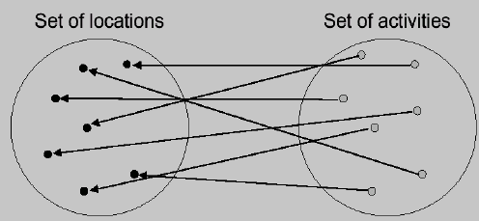
Quadratic Assignment Problem (QAP)
A set of n (activities / items) must be assigned to n (locations / resources) in such a way that a cost function of the couplings is minimized.

Slide 29
Applying ACO to QAP
The Nodes of the Graph are locations.
Ants goal is to visit all locations and to couple one activity to one location.
The Pheromone trial Tij represents the learned desirability of setting P(i) = j, and is used to build a solution.
Ants memorize the activities still to be assigned and are constrained to unassigned activites.
A Heuristics is used to guide the solution.

Slide 30
Routing of data traffic in communication networks to optimize throughput.
Time dependent costs, varying environment.
Each ant has defined source/destination
Each node has a vector of pheromone trails with one entry for each final destination.
Ants deposit pheromone on their respective trail.

Slide 31
ACO to Satellite Image Classification (SIC).
Satellite Image Classification
Involves grouping pixels into distinct labels
Necessary for subsequent analysis of the image
Image Classification Process:
  Supervised
  Unsupervised
Remote Sensing
Remote Sensing is defined as the art and science of obtaining information about any object without coming in direct contact with it.
The term is associated with the process of obtaining information about the earth.

Slide 32
SIC : Schematic Diagram
Reflectance detected by sensor
Incoming Radiation

Slide 33
Applying ACO to SIC
Create n groups of ants
Make each group search for a particular spectral combination that corresponds to a distinct feature - vegetation, clouds etc.
Allow them to mark a pixel to indicate they have 'classified' a pixel as belonging to a particular category (analogous to trail laying in real ants)
An ant belonging to group 'a' tends to move onto pixels marked as belonging to the same group (analogous to trail following in real ants)
Trails can be strengthened by this method
Multiple ants can lay trails over the same pixel and the pixel is classified as belonging to the group with the highest trail strength

Slide 34
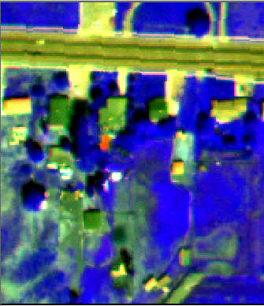
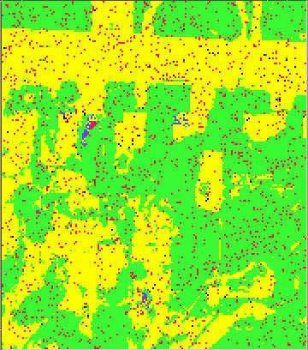
Preliminary Results of SIC
Original Image
After Classification
Figure: Recognizing Vegetation, water and soil.

Slide 35
Conclusions of ACO to SIC.
Plus Points
Ants are able to classify the image!
Able to identify vegetation
Able to identify bare soil
Minus Points
Buildings wrongly identified as soil
Shadows mistaken for water bodies

Slide 36
General design criteria
Number of ants
Balance of exploration and exploitation
Combination with greedy heuristics or local search
When are pheromones updated?

Slide 37
O u t l o o k
ACO is a promising heuristic
  for changing environment and additional constraints
  which can easily be combined with local search or alternatives
but it is only applicable to specific graph-like problems
and only little theory exists so far
(ACO book by Marco Dorigo and Thomas)

Slide 38
ACO Applications
Traveling Salesman Problem (TSP).
Vehicle Routing Problem (VRP).
Sequential Ordering.
Quadratic Assignment Problem (QAP).
Graph Coloring.
Network Routing.
Scheduling
Flow Shop
Satellite Image Classification.

Slide 39
ACO results for More problems
TSP: good but not optimal
QAP: best available heuristic for structured problems
Job-Shop-scheduling: preliminary results
Vehicle routing: among the best methods for routing with time window constraints
Sequential ordering: best available heuristic
Graph colouring: good, but not the best
Shortest common super-sequence: among the best
Multiple knapsack problem: preliminary results

Slide 40

Bibliography
Conferences
  Ants WorkShop series 98, 2000, 2002, 2004.
Web pages
  YurtSeven.org
  Iridia.org
  CiteSeer.ist.psu.edu
  CleverCS (A form for clever computer science ideas)

Slide 41
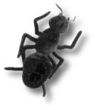
Don’t Worry, I will be there; Everywhere.
-Abhijith.
Notes:
Always find a nice way to say Thanks.

Slide 42
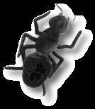
T h a n k Y o u
Notes:
Always find a nice way to say Thanks.

